Slide 1
Final Project Presentation
Credit Score Classification & Prediction
Team Members:
Vinothini, Apoorvan, Angel, Vaishali, Monish, Sakthivel
Research Supervisor:
Mr. Ankush Bansal

Slide 2
Introduction to the Problem Statement
Problem Statement: Traditional credit scoring models rely mainly on financial data and lack behavioral insights, leading to lower predictive accuracy.
Objective: Utilize machine learning techniques to enhance credit score classification accuracy and automate decision-making.
Business Impact:
Enhances financial risk assessment
Reduces manual processing time
Improves decision-making in loan approvals

Slide 3
Dataset & Domain & Project Life Cycle
Dataset Overview: 100,000 rows, 28 variables, covering 12,500 customers over 8 months.
Feature Categories:
Demographic: Age, Occupation
Financial: Annual Income, Num_Bank_Accounts, Interest_Rate, Monthly_Balance etc
Behavioral: Payment History, Num_Credit_Inquiries, Total_EMI_per_month, etc
Target Variable: Credit Score (Good, Standard, Poor)
Project Life Cycle:
Data Collection → Preprocessing → Exploratory Data Analysis (EDA) → Model Building → Model Evaluation
Methodology: Supervised Learning (Classification)

Slide 4
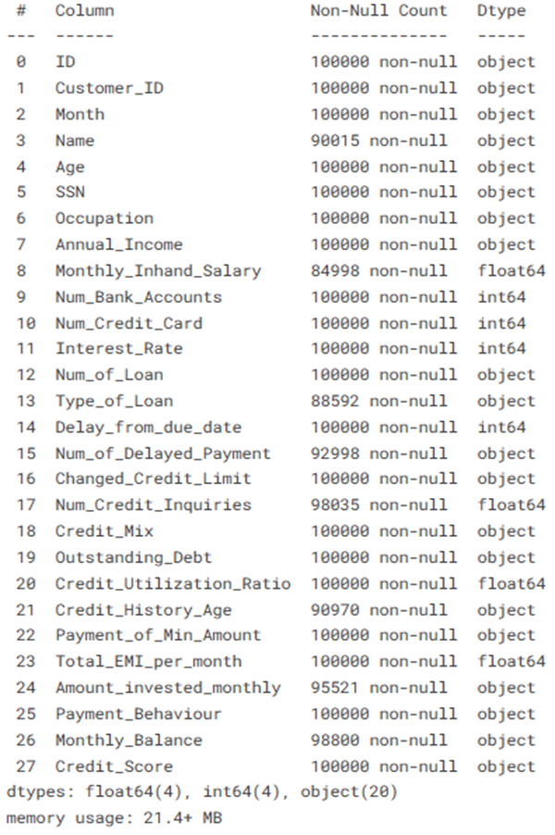
Handling Missing Values​
The dataset had missing values in critical features such as annual_income, monthly_inhand_salary, no_of_loans, etc which are essential for credit score prediction. To handle this, we used the K-Nearest Neighbors (KNN) Imputer, which identifies the k-nearest neighbors based on feature similarity and imputes missing values with a weighted average from those neighbors.​
Why KNN?​
Preserves relationships between variables.​
Ideal for clustered financial data.​
Reduces bias compared to mean/median imputation.​
After applying KNN, the dataset was reviewed to ensure:​
No missing values remained.​
The imputed values aligned with expected patterns.
Data Cleaning & Preprocessing

Slide 5
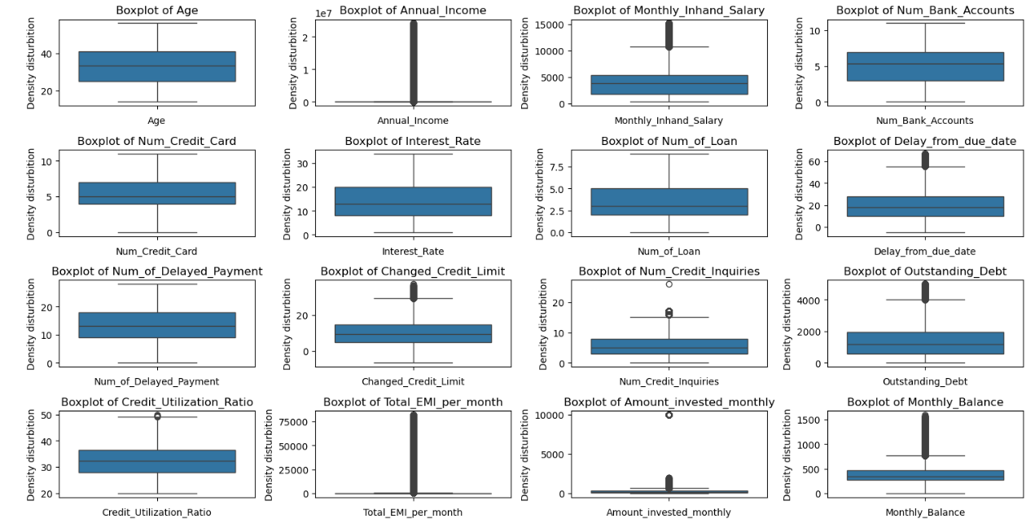
Outlier Detection & Handling
Outliers were detected using the Interquartile Range (IQR) method, flagging values that lie beyond 1.5 times the IQR from the first and third quartiles. Box plots and histograms were also used for visual validation.​
Outliers found in:​
Non-financial columns (e.g., Age, Number of Loans): Data entry errors like Age = 1000,200 etc​
Financial columns (e.g., Credit Utilization, Outstanding Debt): Extreme debt or utilization values.​
To handle outliers, a two-pronged approach was applied:​
Imputation for non-financial outliers: Extreme values were replaced by NaN and imputed using KNN.​
Retention of financial outliers: These were kept to capture valuable insights into high-risk customer behavior.​
This ensured meaningful data was preserved without compromising dataset consistency.

Slide 6
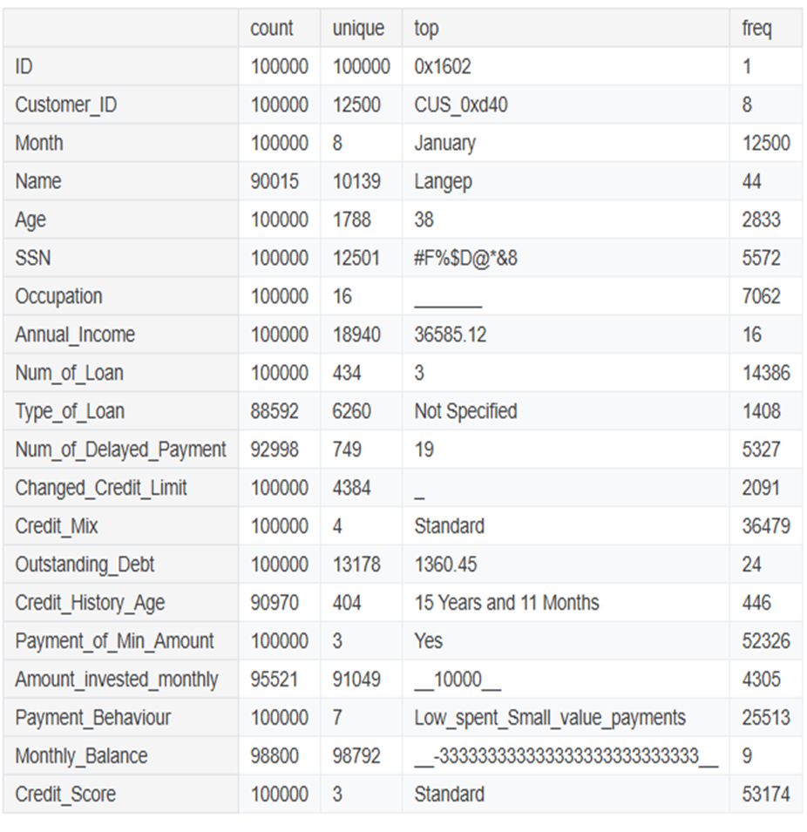
Invalid & Inconsistent Values
Several invalid and inconsistent values were found across numeric and categorical features. After that we binned Age and Monthly balance as Balance group for better performance.
Key actions taken:​
Replaced invalid characters in numeric columns with appropriate values.​
Standardized categorical values by removing inconsistent symbols.​
Validated numeric fields to ensure they contained valid numeric values.​
This process ensured a clean dataset ready for analysis without errors or inconsistencies.​
Data Cleaning Challenges​
Missing Values: Accurate imputation for features with varied distributions.​
Extreme Values: Balancing correction of non-financial features with preserving insights from financial data.​
Invalid Values: Detecting and replacing malformed entries with careful column analysis.​
Outliers: Deciding which outliers to treat versus retain, based on their relevance.

Slide 7
Exploratory Data Analysis (EDA)
Univariate Analysis:
Histograms & Density Plots: Show right-skewed distributions for salary and credit utilization.
Box Plots: Identify outliers in Annual Income, Outstanding Debt, and Credit Utilization.
Pie Charts: Credit Mix shows most individuals fall under Standard (45.8%).
Bivariate Analysis:
Scatter Plots: Annual Income clusters indicate salary bands.
Bar Plots: Poor credit scores linked to higher loans.
Histograms: More than ten credit inquiries often correlate with Poor credit scores.
Count Plots: Credit Mix influences credit score classification.
Multivariate Analysis:
Heatmaps: Higher salaries correlate with better credit scores.
Bar Plots: Outstanding debt is consistently higher for Poor credit scores.
Count Plots: Payment behavior impacts debt levels and credit scores.

Slide 8
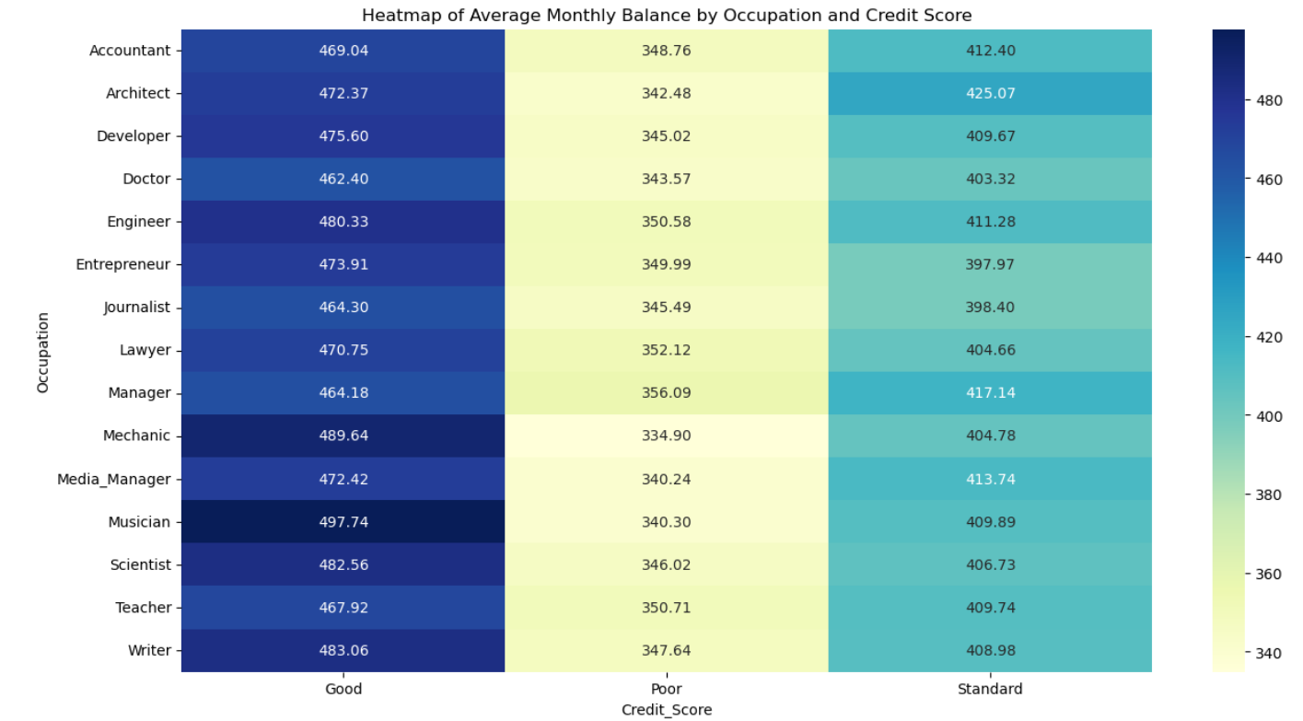
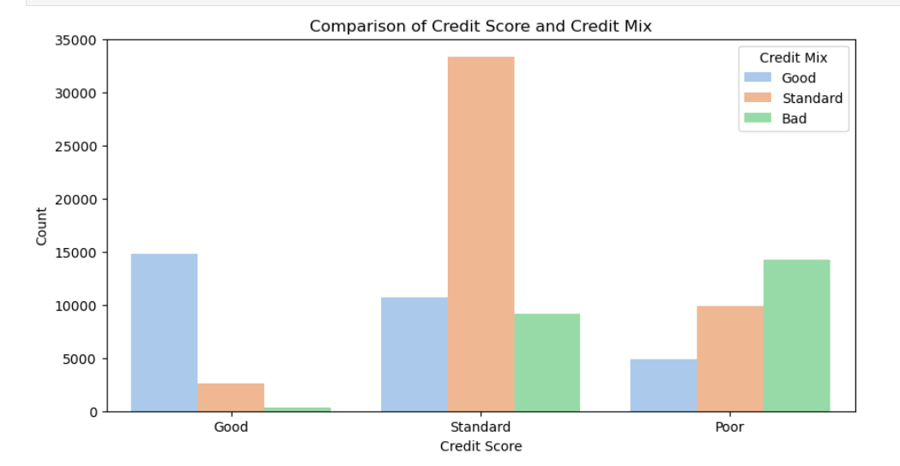
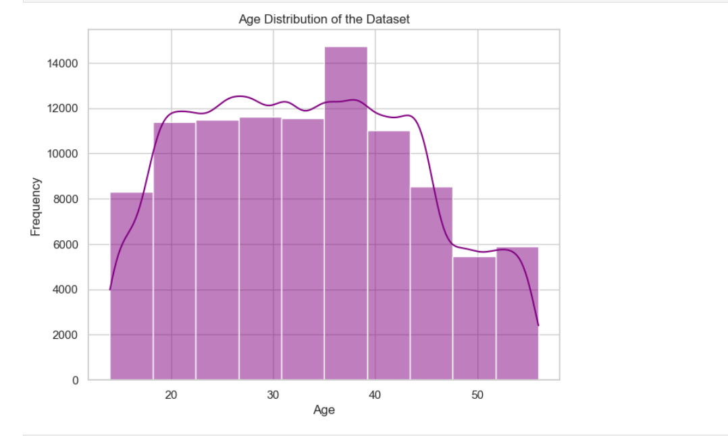
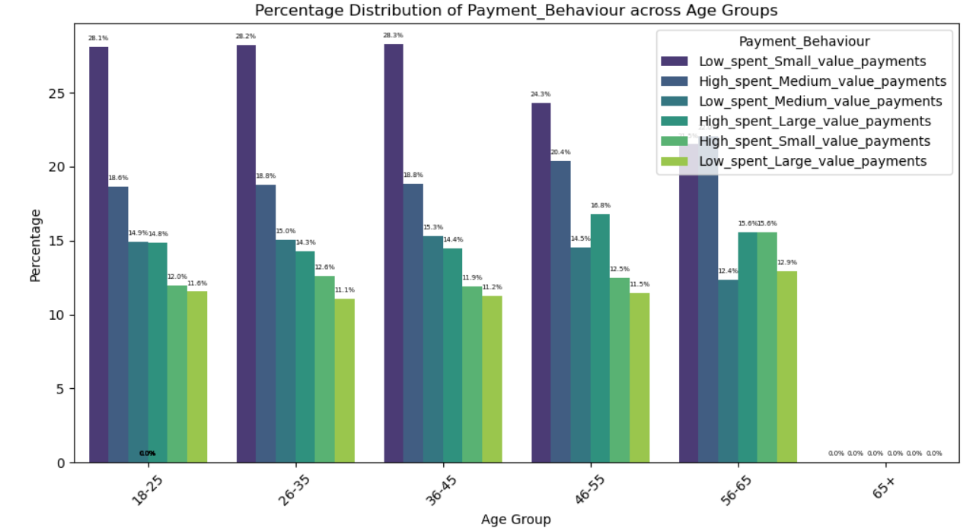
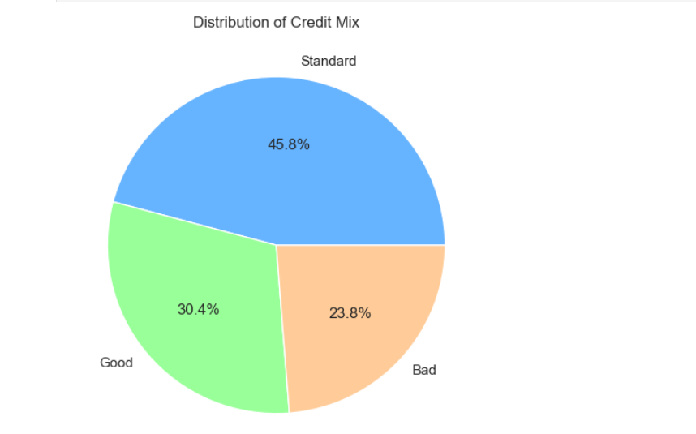

Slide 9
Hypothesis Testing & Multicollinearity Analysis
ANOVA Test (Num vs Cat):
Identifies significant differences in financial indicators across credit score categories
Rejected null hypothesis, confirming numerical predictors impact credit score
Chi-Square Test (Cat vs Cat):
Examined associations between categorical variables and credit score
Confirmed significant relationships, justifying feature selection
Variance Inflation Factor (VIF) Analysis:
Identified highly correlated variables (e.g., Credit Utilization Ratio, Num_Credit_Cards)
Retained multicollinear features for further analysis instead of removal

Slide 10
Encoding & Scaling
Encoding Categorical Variables:
Categorical columns were encoded using Label Encoding, transforming them into numerical values compatible with machine learning models. Encoders were stored for future use (e.g., inverse transformation). The dataset was split into features (X) and target (y), with Credit Score as the target, ensuring relevant data for training.
Scaling:
Irrelevant columns and significant outliers were handled to avoid distortion.
Scaling was applied in stages:
Before KNN Imputation: Scaled data ensured consistent imputation.
Visualization: Reversed scaling for clarity.
Model Building: Standardized features using StandardScaler (mean = 0, std = 1) to enhance model performance, especially for scale-sensitive algorithms.
After Scaling, the multi collinearity between the variables dropped to <5.

Slide 11
Model | Accuracy | Performance Analysis | Strengths | Weaknesses
Logistic Regression | 60% | - Struggles with non-linear relationships. - Poor performance with features like Payment Behaviour & Credit Utilization. - Affected by class imbalance. | - Simple and interpretable. - Computationally efficient. | - Assumes linear relationships. - Sensitive to imbalanced data.
Decision Tree Classifier | 70% | - Captures non-linear relationships and feature interactions well. - Prone to overfitting with deeper trees. | - Provides interpretability and feature importance. - Handles non-linearity effectively. | - Overfits if not pruned or hyperparameter-tuned. - Sensitive to small data changes.
Random Forest Classifier | 67.5% | - Good at capturing complex patterns and reducing overfitting. - Slight underfitting due to limited max_depth. | - Reduces overfitting through ensembling. - Provides feature importance insights. | - Computationally expensive for large datasets. - Requires tuning for optimal performance.
K-Nearest Neighbors (KNN) | 72% | - Captures complex decision boundaries well. - Performance depends on the value of k and distance metric. It prone to overfitting | - Non-parametric and adaptable to various datasets. - Performs well with structured data. | - Computationally expensive for large datasets. - Sensitive to irrelevant features and noise.
Model Performance

Slide 12
Model Evaluation & Improvements
Logistic Regression
Improvements: Enhance feature engineering, address class imbalance with SMOTE, and use non-linear transformations.
Decision Tree Classifier
Improvements: Tune hyperparameters, use ensemble methods (Random Forest/Gradient Boosting), and apply cross-validation.
Random Forest Classifier
Improvements: Tune hyperparameters, explore XGBoost/LightGBM, and apply cross-validation.
K-Nearest Neighbors (KNN)
Increase k to reduce overfitting, apply cross-validation, use feature selection and PCA, and optimize distance metrics for better generalization.

Slide 13
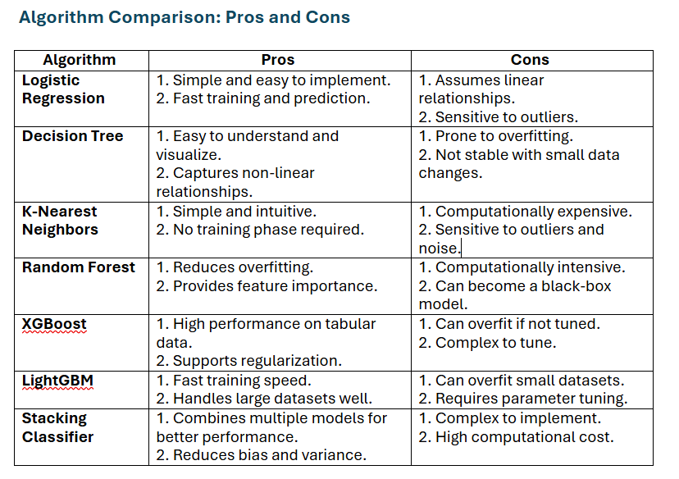

Slide 14
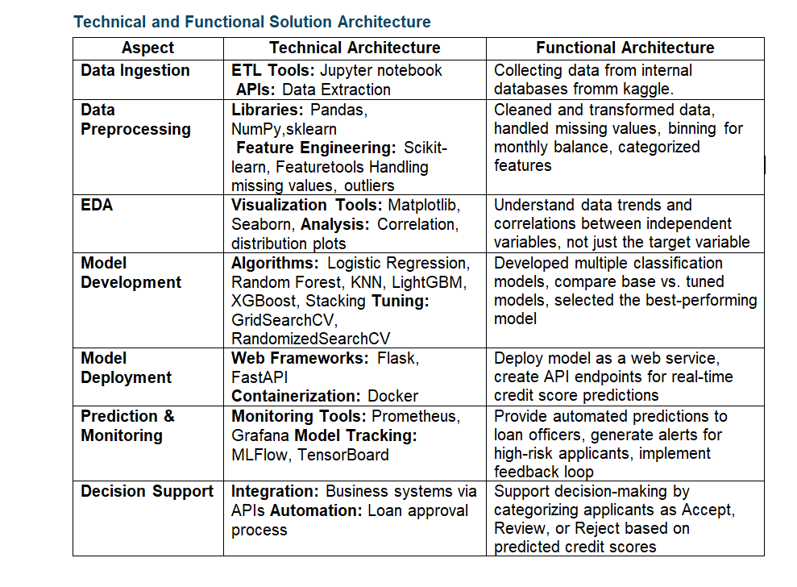

Slide 15
Model Comparisons
Random Forest
Features: 14 (85% importance)
Accuracy: Train - 81.55%, Test - 75.76%
Observation: Improved test accuracy from 67.5% but shows slight overfitting.
KNN
Features: 8 (80% importance, mutual information)
Accuracy: Train - 91.88%, Test - 77.93%
Observation: High overfitting despite accuracy improvement.
Decision Tree
Features: 9 (85% importance)
Accuracy: Train - 75.92%, Test - 71.41%
Observation: Improved generalization, less overfitting than KNN.
XGBoost
Features: 9 (90% importance)
Accuracy: Train - 71.58%, Test - 70.59%
Observation: Strong regularization, lower accuracy than RF & KNN.
LightGBM
Features: 15 (85% importance)
Accuracy: Train - 75.75%, Test - 72.16%
Observation: Balanced precision & recall, better stability than RF & KNN.
Stacking Classifier (Best Model)
Features: 19 (combined from all models)
Accuracy: Train - 82.63%, Test - 77.19%
Observation: Outperformed all models with minor overfitting

Slide 16
Performance Metrics Interpretation
Log Loss
Stacking Classifier (0.5423) had the lowest log loss, making it the most reliable in confidence of predictions.
KNN (3.5171) had the worst log loss, indicating extreme overfitting.
XGBoost (0.6506) had the highest log loss among boosting models, showing that its predictions were less confident.
Precision & Recall
Stacking Classifier achieved the best balance (Precision: 77%, Recall: 77%), making it robust for generalization.
KNN had the highest recall (78%) but suffered from significant overfitting, meaning it classified more positives but with less reliability.
Decision Tree and XGBoost had lower recall (71%) but were more stable models with better generalization.
F1-Score
Stacking Classifier achieved the highest F1-score (77%), confirming its balanced trade-off between precision and recall.
Decision Tree had the lowest F1-score (71%), indicating weaker generalization.
XGBoost (71%), despite its strong regularization, struggled to maintain an optimal balance.

Slide 17
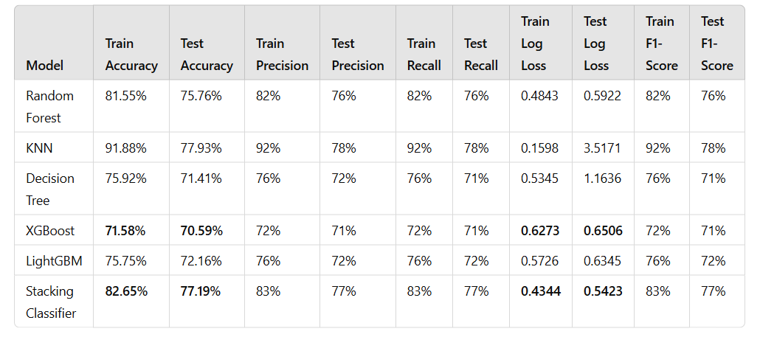
Models and performance Evaluation Metrics

Slide 18
How to take it to production
1. Seamless Model Deployment & Integration​
Integrate the credit score classification model with banking systems to enable real-time and historical data analysis.​
Set up scalable cloud or on-premises infrastructure to handle large data volumes and transactions efficiently.​
2. Enhancing Banking Operations​
Automate loan approvals with instant creditworthiness assessments, reducing processing time and costs.​
Improve risk management by accurately predicting defaults, helping banks optimize lending strategies.​
3. Regulatory Compliance & Model Validation​
Ensure adherence to financial regulations by maintaining transparency and fairness in credit decisions.​
Conduct independent validation and rigorous testing to detect biases and ensure model reliability.​
4. API Development & System Integration​
Develop secure APIs to allow various banking applications to interact with the model for real-time credit scoring.​
Ensure smooth integration with existing banking software to provide seamless and efficient decision-making.​
5. Continuous Monitoring & Improvement​
Implement real-time monitoring to track model performance and detect any drifts in accuracy.​
Regularly retrain the model with updated data to adapt to changing customer behaviors and market conditions.​
6. Customer & Staff Engagement​
Train banking staff to effectively utilize the system, ensuring smooth adoption.​
Provide transparency to customers regarding how their credit scores are assessed, fostering trust in the process.​
7. Personalized Financial Services & Customer Experience​
Offer tailored financial products and credit options based on customers’ credit profiles.​
Improve customer satisfaction by providing proactive credit score improvement suggestions and financial guidance.

Slide 19
Any follow-up potential capstone project problems
Bias & Fairness in Credit Scoring Models​
Investigate bias in credit classification models related to demographic features such as age, gender, and occupation.​
Real-Time Credit Scoring with Streaming Data​
Instead of relying on static datasets, integrate real-time financial.​
Alternative Data for Credit Scoring (Social & Behavioral Insights)​
Many individuals lack formal credit histories, making traditional scoring models ineffective.​
Credit Default Prediction & Loan Risk Assessment​
Instead of just classifying credit scores, build a model to predict credit default risk for loans using time-series data.​
Fraud Detection in Credit Transactions​
Extend your project to detect anomalous financial activities that indicate fraudulent behavior.​

Slide 20
Conclusion
Best Model: After evaluating multiple classifiers, Stacking Ensemble (Decision Tree, XGBoost, LightGBM) with Random Forest as the meta-model delivered the best performance with the highest accuracy and generalization.
Performance Improvement: Stacking improved predictions by combining the strengths of multiple models, effectively reducing bias and variance while enhancing model robustness.
Feature Importance Analysis: Feature importance was calculated using Random Forest, XGBoost, LightGBM, and Decision Tree, identifying the most significant features. Irrelevant features were removed to improve efficiency, reduce overfitting, and enhance interpretability.
Hyperparameter Tuning: We applied RandomizedSearchCV to optimize key parameters, fine-tuning model performance and ensuring the best combination of hyperparameters for higher accuracy and stability.
Deployment Strategy:
The final model was serialized using joblib/ONNX for efficient storage and loading.
It was prepared for real-time inference via Flask or FastAPI, ensuring smooth deployment.
Scalability & Production Readiness: The model is optimized for real-world applications, making it scalable and ready for production integration in automated decision-making systems.
Limitations: Stacking provides higher accuracy but comes with increased computational cost compared to individual models. Efficient resource management is required for deployment.
Next Steps: Future improvements include continuous model monitoring, deployment optimization in a cloud environment, and exploring deep learning techniques for further enhancements.

Slide 21

Thank you !

